Slide 1



Effects of Social media on Students
Presented by- Shreyasi Kayam

Slide 2



Introduction
Objective of study
Data description
Results
Conclusion
References
Appendix
Contents

Slide 3


Introduction

Slide 4


Introduction
Social media is a computer-based technology that makes it easier to share information, ideas, and opinions through online communities and networks. Social media encompasses a wide range of applications and platforms that let users communicate online, from Instagram to Twitter.

Slide 5
Objective of study
This study examines the relationship between social media and the mental health status of students. The objective of our study is to check whether social media usage has a significant impact on mental health issues of a student i.e. anxiety and loneliness.

Slide 6
To conduct this study, a web-based survey gathered data from a total of 100 undergraduate students of St. Xavier’s College, Kolkata.
Out of the 100 participants, 65 were females and 35 were males.
We have the following variables?
1. Social media usage 2. Anxiety 3. Loneliness
The three variables in this study are measured using three distinct scales. Social media usage by the Social Media Engagement Questionnaire (SMEQ), Anxiety by Generalized Anxiety Disorder Scale (GAD-7) and Loneliness was measured by UCLA Loneliness scale.
Data

Slide 7


Results

Slide 8
Variables | N | Minimum | Maximum | Mean | Std. Deviation
Social Media Usage | 100 | 0.000 | 35.000 | 16.310 | 9.695
Tables
Variables | N | Minimum | Maximum | Mean | Std. Deviation
Anxiety | 100 | 0.000 | 21.000 | 9.570 | 5.840
Variables | N | Minimum | Maximum | Mean | Std. Deviation
Loneliness | 100 | 3.000 | 9.000 | 6.000 | 1.864

Slide 9

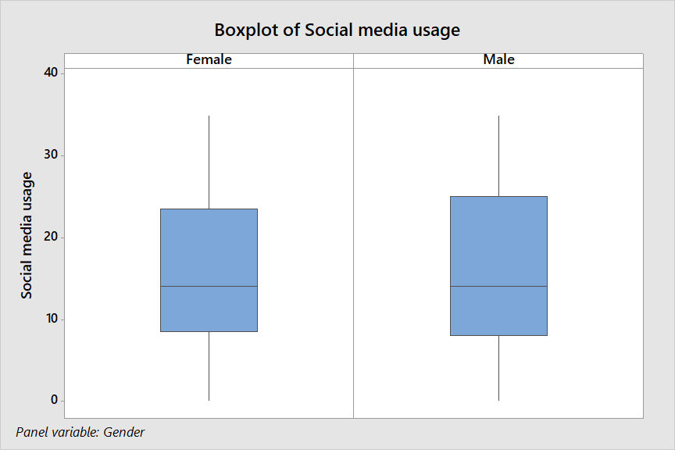
Graph 1
The median for both the genders is 14, thus on an average both males and females have moderate social media usage. The IQR for males is 17 and for females is 14. For females, there is lesser spread in the middle 50% of the data than for males. For females there is slightly lesser variability in the data than for males.

Slide 10
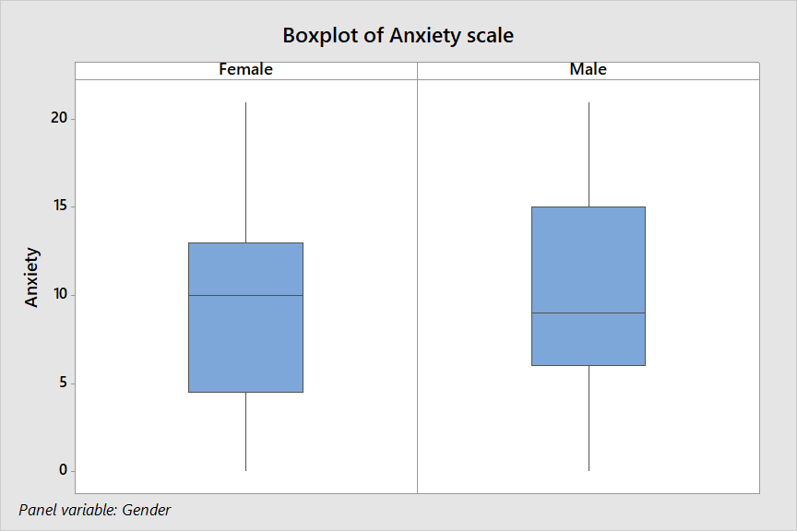
Graph 2
The median for males and females is 9 and 10 respectively. This means that the mean anxiety level is higher for females. IQR for males is 9 and for females is 8.5. For females, there is lesser spread in the middle 50% of the data than for males. For females there is slightly lesser variability in the data than for males. 3 rd quartile (Q3) for males is 15 and for females is 13 i.e. the highest 25% of the anxiety scores for males is higher than that for females.

Slide 11
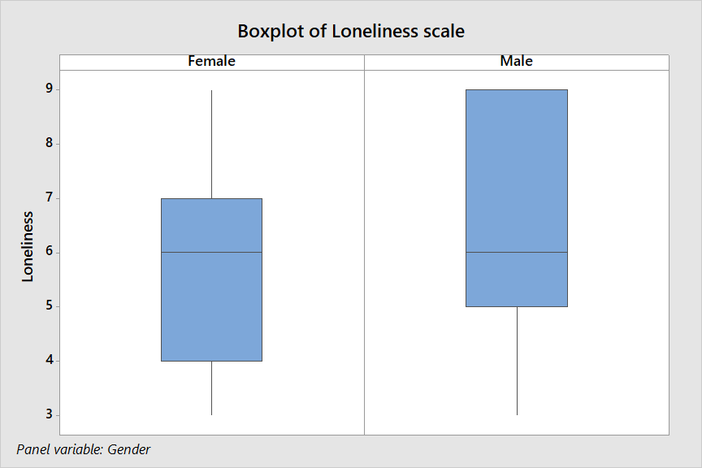
Graph 3
The median for both the genders is 6. IQR for males is 4 and for females is 3.For females there is slightly lesser variability in the data than for males. 3 rd quartile (Q3) for males is 9 and for females is 7. The highest 25% of the loneliness scores for males is even higher than all the loneliness scores for females. Thus, comparatively loneliness level is more in males than in females.

Slide 12

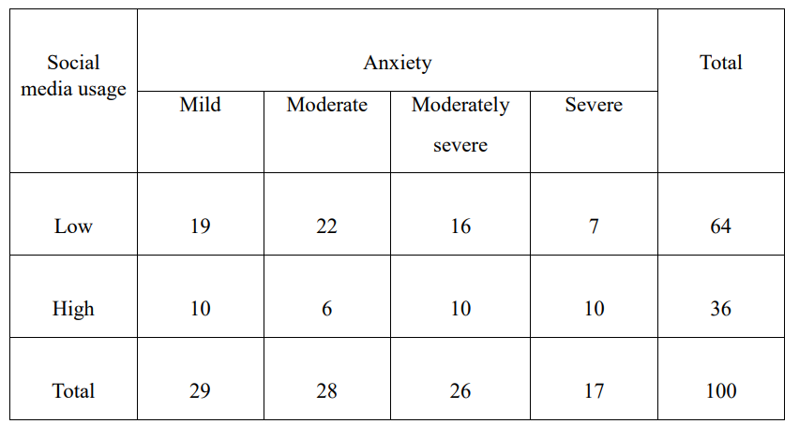
Contingency table 1
A 2X4 CONTINGENCY TABLE
Let A denote Anxiety
and B denote Social media usage. Both the attributes A and B are ordinal.

Slide 13
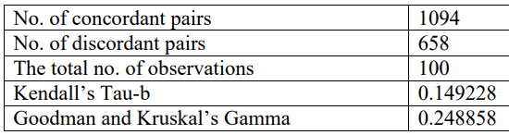

Values
To judge the association between anxiety(A) and social media usage(B) of a person, Kendall’s measure of concordance (Kendall’s Tau-b) and Goodman and Kruskal’s Gamma are calculated.
Using the table obtained from Minitab,we can conclude that, there is a moderate association between Anxiety and social media usage of a person i.e. a person with high social media usage is perceived to have high anxiety level.

Slide 14
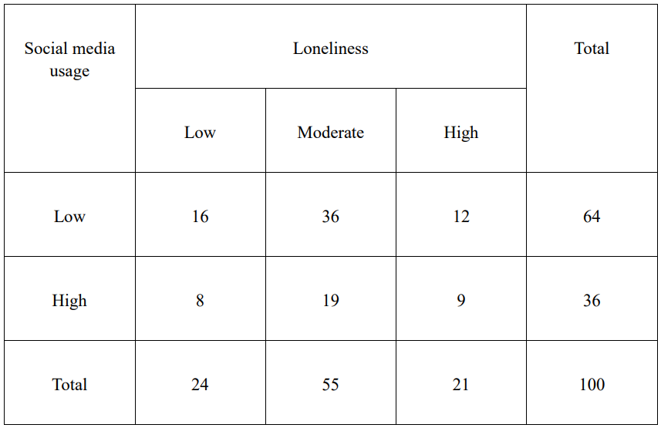
Contingency table 2
A 2X3 CONTINGENCY TABLE
Let X denote Loneliness
and Y denote Social media usage. Both the attributes X and Y are ordinal.

Slide 15
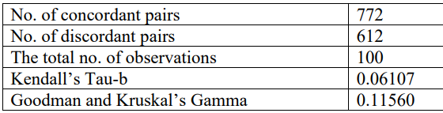
Values
To judge the association between loneliness(X) and social media usage(Y) of a person, Kendall’s measure of concordance (Kendall’s Tau-b) and Goodman and Kruskal’s Gamma are calculated.
Using the table obtained from Minitab, we can conclude that, there is a mild association between Loneliness and social media usage of a person i.e. a person with high social media usage is perceived to have high loneliness level.

Slide 16


Ordinal Logistic Regression
We use ordinal logistic regression to model the relationship between the predictor(social media usage) and the response(anxiety).
Let Y denote anxiety and X denote social media usage. So we are provided with the data (y1,x1),....,(yn,xn) where n=100 which is the total number of data points.

Slide 17
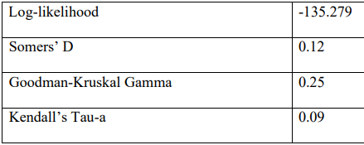
INTERPRETATION
To test, H0 : There is no association between social media usage and anxiety.
H1 : Not H0
The p-value has come out to be 0.087. As the p-value > α, we cannot conclude that the association between the response and the predictor is statistically significant.
Small value of log-likelihood indicates that the model is not a good fit to the data. Somers’ D, Goodman-Kruskal Gamma, Kendall’s Tau-a have values close to zero which indicates that the model does not have a predictive relationship with the response. The relationship between social media usage and anxiety is weak.

Slide 18
Ordinal Logistic Regression
We use ordinal logistic regression to model the relationship between the predictor(social media usage) and the response(loneliness).
Let Z denote loneliness and X denote social media usage. So we are provided with the data (z1,x1),....,(zn,xn) where n=100 which is the total number of data points.

Slide 19
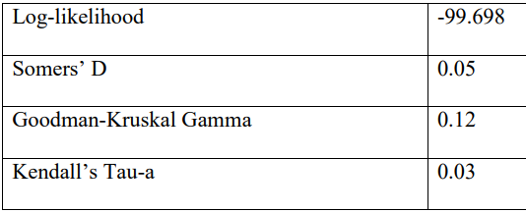
INTERPRETATION
To test, H0 : There is no association between social media usage and loneliness.
H1 : Not H0
The p-value has come out to be 0.519. As the p-value > α, we cannot conclude that the association between the response and the predictor is statistically significant.
Small value of log-likelihood indicates that the model is not a good fit to the data. Somers’ D, Goodman-Kruskal Gamma, Kendall’s Tau-a have values close to zero which indicates that the model does not have a predictive relationship with the response. The relationship between social media usage and loneliness is weak.

Slide 20
Conclusion
The study shows that there is a moderate positive association of social media usage with anxiety as well as loneliness. But, it cannot exactly be used to predict the level of anxiety and loneliness in a student. Social media usage is not a causing factor.

Slide 21
References
Social Isolation and Loneliness in Older Adults: Opportunities for the Health Care System
Effects of Social media use on Psychological Well- Being: A Mediated Model
Generalised Anxiety Disorder assessment (GAD-7)

Slide 22
QUESTIONNAIRE
Gender
How many hours of the day do you use your social media accounts?
Appendix

Slide 23
(The following questions have responses ranging from Not one day - Everyday)
How often did you use social media in the 15 minutes before you go to sleep?
How often did you use social media in the 15 minutes after you wake up?
How often did you use social media when eating breakfast?
How often did you use social media when eating lunch?
How often did you use social media when eating supper?

Slide 24
(For the following questions responses are - Hardly ever, some of the time, Often)
How often do you feel that you lack companionship?
How often do you feel left out?
How often do you feel isolated from others?
(For the following questions responses are - Not at all, Several days, Over half the days, Nearly everyday)
Feeling nervous, anxious, or on edge.
Not being able to stop or control worrying.
Worrying too much about different things.
Trouble relaxing.
Being so restless that it’s hard to sit still.
Becoming easily annoyed or irritable.
Feeling afraid as if something awful might happen.

Slide 25
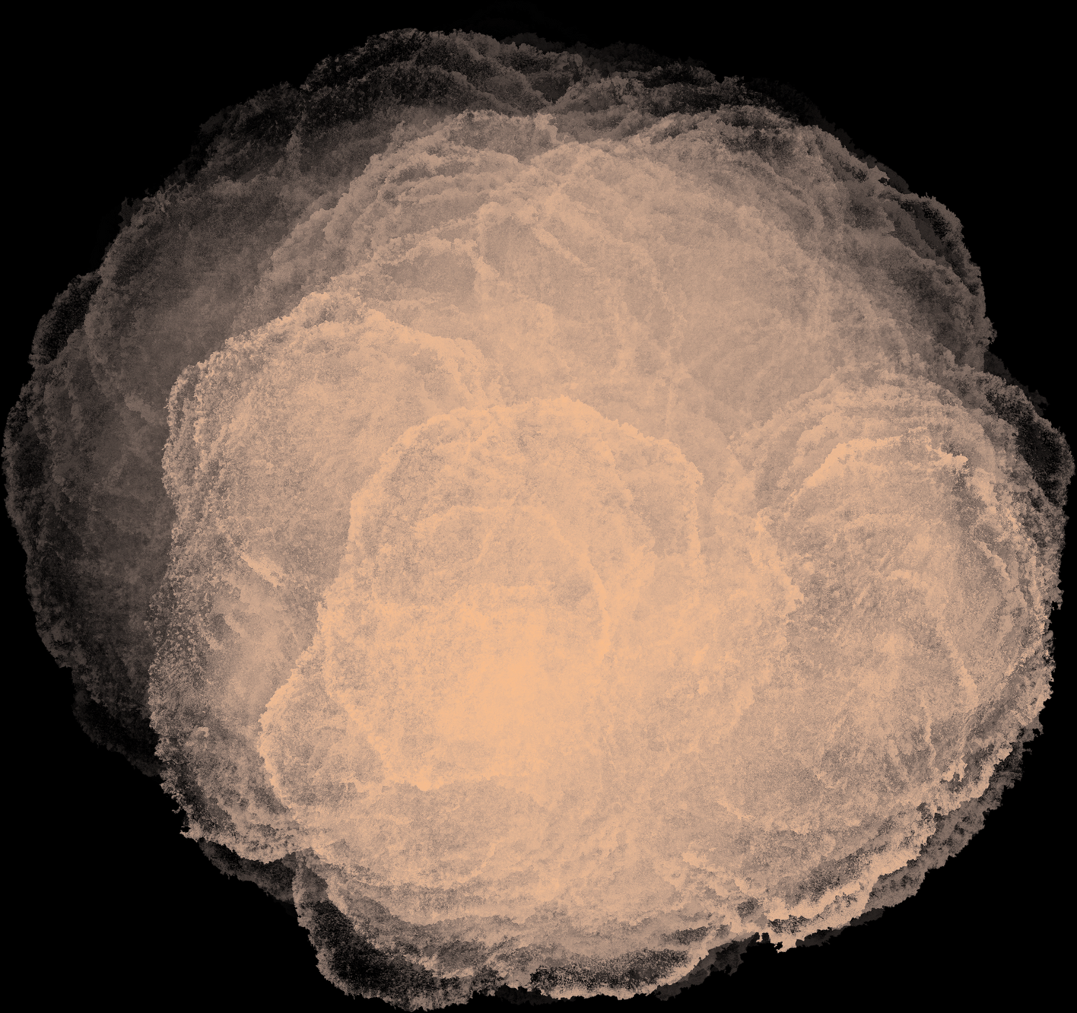
Thank
you

